Slide 1
Service Level Agreements
PP Course

Slide 2
SLA
A service level agreement (SLA) is a documented agreement between a service provider and a customer that identifies both the services required and the expected level of service. The agreement varies between vendors, services, and industries.

Slide 3
Basic constituents of SLA
Review or monitoring. How often the Service Provider and Customer may review the SLA, perhaps annually.
Service credits. Something the Service Provider may offer in case your SLA is not achieved.
Rider. Used when amendments occur.
End-of-contract or liquidation terms. Defining how and when Customer or Service Provider can opt out of the SLA.

Slide 4
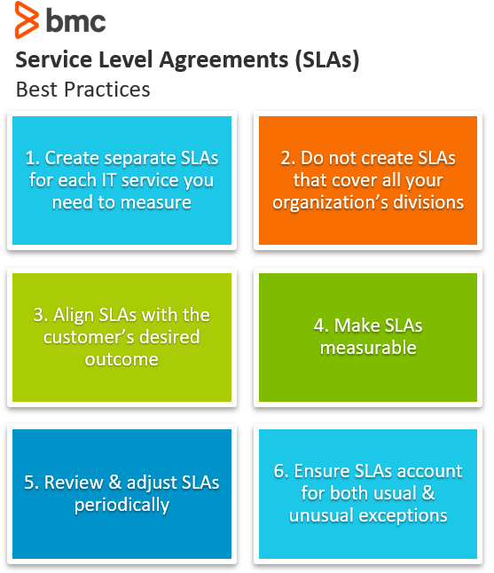

Slide 5
